Slide 1




Development of master curricula for natural disasters risk management in Western Balkan countries
Established practices and study programmes in Hungary
Ágota Drégelyi-Kiss, PhD
Bánki Donát Faculty of Mechanical and Safety Engineering,
Óbuda University, Hungary
Workshop on master curricula best practices in EU partners/
5-7 April, 2017, Vienna
Project number: 573806-EPP-1-2016-1-RS-EPPKA2-CBHE-JP
"This project has been funded with support from the European Commission. This publication reflects the views only of the author, and the Commission cannot be held responsible for any use which may be made of the information contained therein"

Slide 2
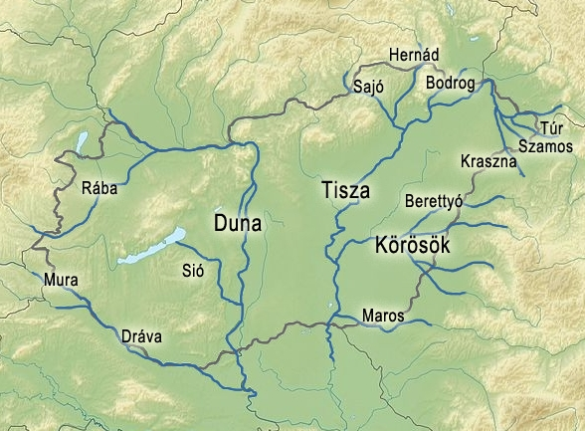
1. Identification of natural disasters
Development of master curricula for natural disasters risk management in Western Balkan countries
Flood protection has thus historically been an important task for its inhabitants. The two largest rivers are the Danube and Tisza. Over 50 % of the overall territory of Hungary, including two thirds of the arable land is endangered by flood hazards. On the Danube with a 10 -12 year interval and on the Tisza every 5-6 years, there are larger floods.

Slide 3
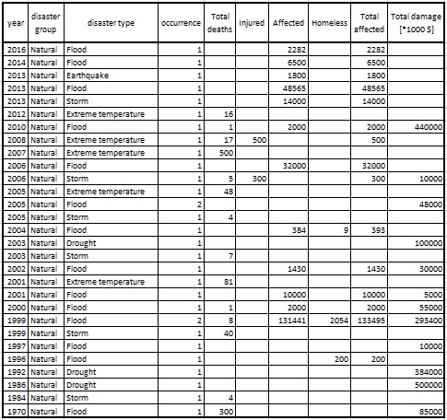
1. Identification of natural disasters
Development of master curricula for natural disasters risk management in Western Balkan countries

Slide 4
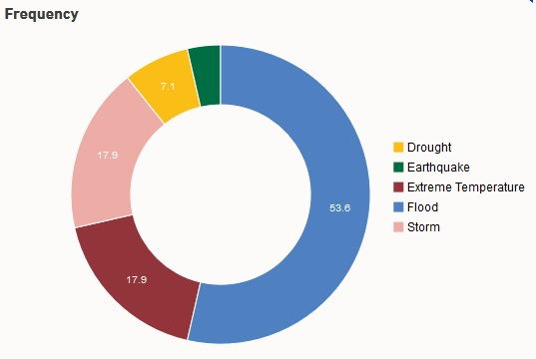
1. Identification of natural disasters
Development of master curricula for natural disasters risk management in Western Balkan countries
According to the Global Assessment Report on Disaster Risk Reduction (GAR), a biennial review and analysis of natural hazards published by the United Nations Office for Disaster Risk Reduction, between 1990-2014 there were several type hazards in Hungary.

Slide 5
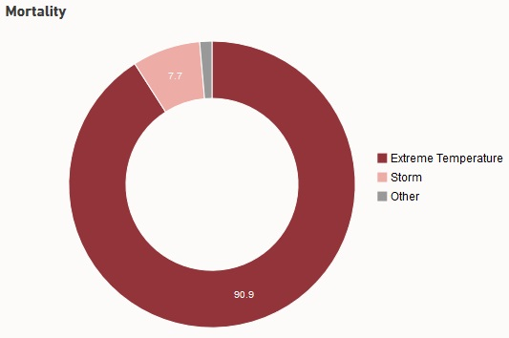
1. Identification of natural disasters
Development of master curricula for natural disasters risk management in Western Balkan countries
Internationally reported losses place extreme temperature as the leading hazard in terms of mortality in Hungary between 1990 – 2014

Slide 6
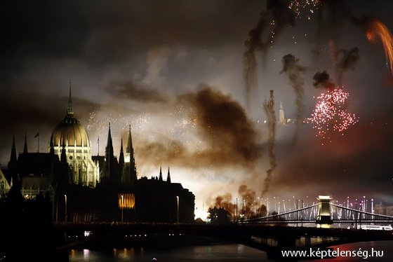
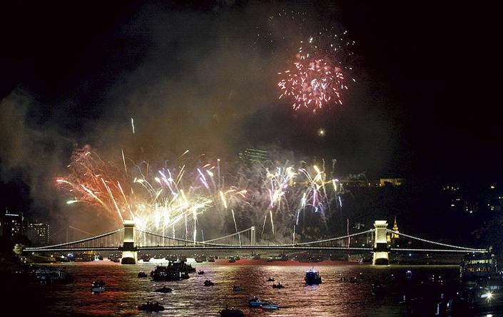
Thunderstorm (2006)
Development of master curricula for natural disasters risk management in Western Balkan countries
Five people died and more than 250 were injured when a storm lashed Hungary's capital, Budapest, as huge crowds watched a firework display.
Torrential rain and winds of up to 100km/h tore down trees, smashed cars and windows and ripped off roof tiles.

Slide 7
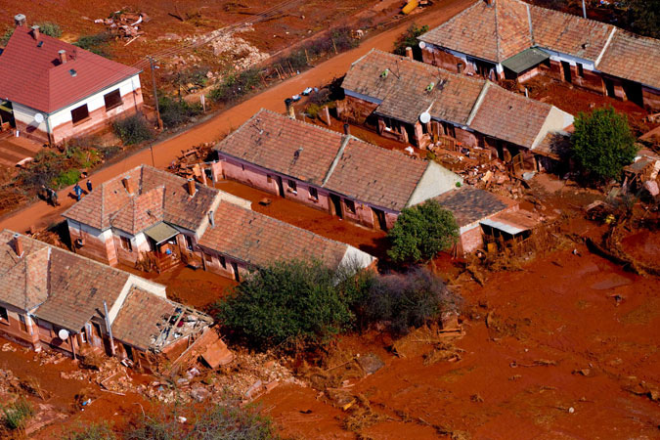
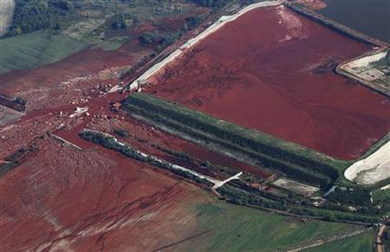
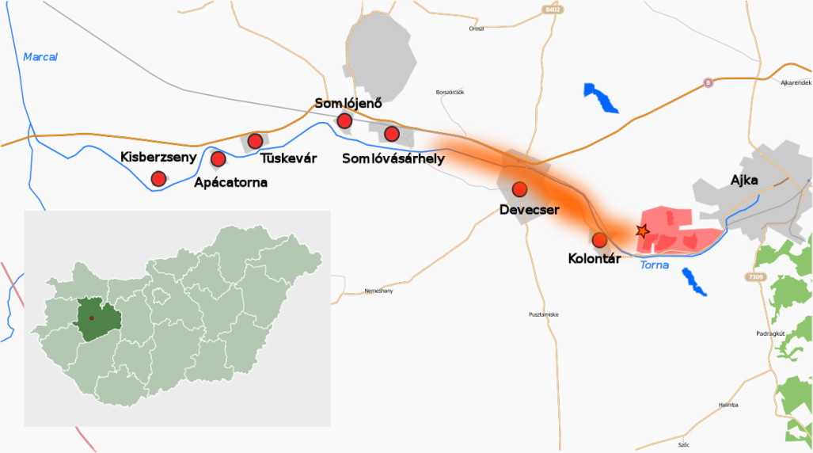
Red sludge accident (2010)
Development of master curricula for natural disasters risk management in Western Balkan countries
The Ajka alumina sludge spill was an industrial accident at a caustic waste reservoir chain of the Ajkai Timföldgyár alumina plant. The mud was released as a 1–2 m wave, flooding several nearby localities, including the village of Kolontár and the town of Devecser.
Ten people died, and 150 people were injured. About 40 square kilometres of land were initially affected.

Slide 8
Law
Development of master curricula for natural disasters risk management in Western Balkan countries
Disaster was officially defined first in 1999 (Disaster Management Law 1999) and further clarified in 2011 (Disaster Management Law CXXVIII /2011).
Disaster is an event that endangers people and people’s goods or infrastructure to such an extent that it is not possible to cope within the normal responsibility and cooperative framework of institutions. A description of conditions related to this special legal order is given in the New Fundamental Law (articles 48-53).

Slide 9
Civil protection
Development of master curricula for natural disasters risk management in Western Balkan countries
1937: civil protection activity started (protecting civilian life and property against air offensives during the war)
1950: the civil protection system was reorganized with the priority task still “protection against air offensives”
1996: civil protection law (XXXVII /1996) enumerated the main tasks of civil protection (as it is stated in the Geneva agreement).
1999: the disaster management law, the Civil Protection Directorate became a part of the disaster management system

Slide 10
Civil protection
The disaster management and civil protection systems are in general separated from the army. However, in case of natural disaster the army can be involved (Defense Law 2004, later 2011 article 36/2).
From 2012: all civil protection and most firefighting tasks were moved under the disaster management authorities. Also, flood protection issues of water management were moved under the Ministry of Interior (previously under the Ministry of Environment).

Slide 11
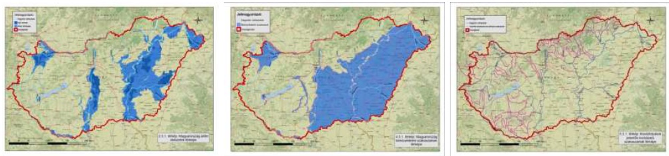
2. Analysis of risk management
Development of master curricula for natural disasters risk management in Western Balkan countries
    Implementation of the Flood Directive in Hungary
  The content of the Commission Directive 2007/60/EC on the assessment and management of flood risks(26/11/2007):
  Designation of managing authority
  Preliminary flood risk assessment (Artt. 4(3))
  Areas of potential significant flood risk (Art. 5(2)) – completed (2011.DEC)
  Flood hazard and risk maps (Art. 6(2)) – completed (2013.DEC)
  Flood risk management plans (art. 8(2)) – completed (2015.DEC)

Slide 12
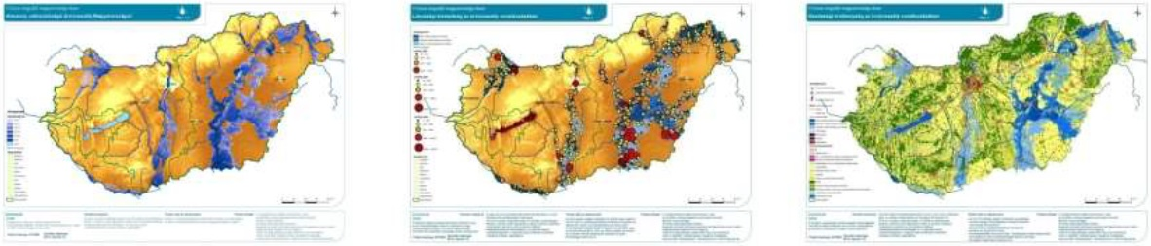
2. Analysis of risk management
Development of master curricula for natural disasters risk management in Western Balkan countries
Preliminary flood risk maps
Hazard and risk maps

Slide 13
2. Analysis of risk management
Development of master curricula for natural disasters risk management in Western Balkan countries
Non-structural, legal and regulatory measures:
  Good national and international cooperation (WG-F, ICPDR FP-EG, Border Comm.)
  Precise flood forecasting: continuous development
  Raising awareness: municipality flood defence plans
  Recalculation of the Design Flood Level (DFL, in Hungarian ‘mértékadó árvíz szint’, MÁSZ) legal update on 100 year defence
  Sustainable floodplain management (plans): short and long term measures

Slide 14
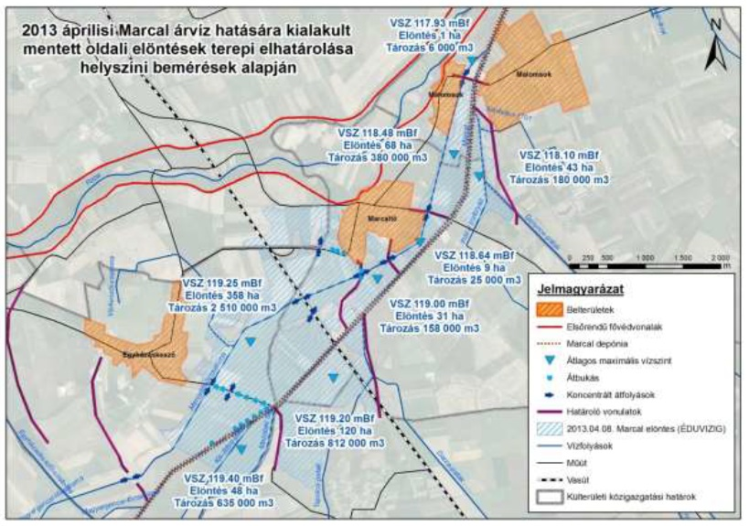
Flood defense plan
Development of master curricula for natural disasters risk management in Western Balkan countries
The recalculation of the design flood level was made in 2014 for all 2800 km diked rivers. The floodplain management plans were also were made in 2014.The hikes are made to the actual design flood level of water. DFL water level is calculated from the historical flood level heights and the frequency of the floods.

Slide 15
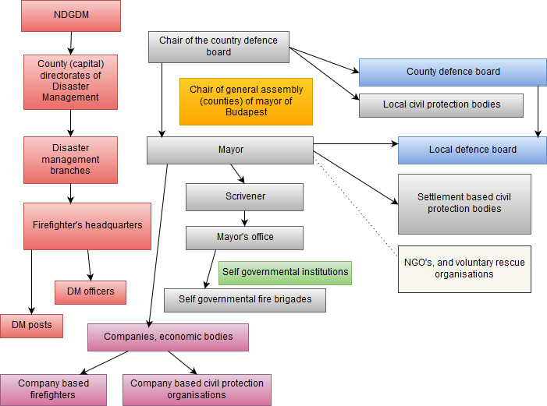
3. Analysis of responsible institutes
Development of master curricula for natural disasters risk management in Western Balkan countries

Slide 16
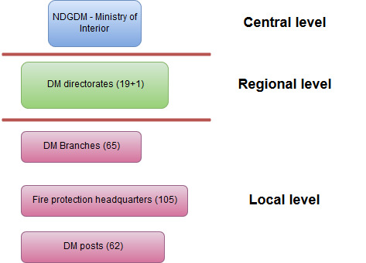
3. Analysis of responsible institutes
Development of master curricula for natural disasters risk management in Western Balkan countries

Slide 17
4. Analysis of EU master curricula
Development of master curricula for natural disasters risk management in Western Balkan countries

